Slide 1
NAÏVE BAYESIAN

Slide 2

Bayes’ theorem
Probability of the outcome
Class conditional probability
Posterior probability
Probability of the conditions

Slide 3
Bayes Classifier
A probabilistic framework for solving classification problems
Conditional Probability:
Bayes theorem:

Slide 4
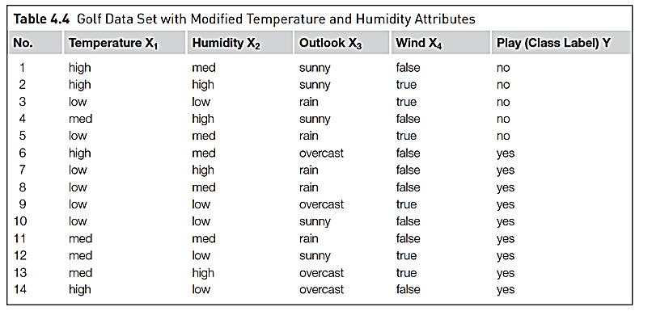
Data set

Slide 5
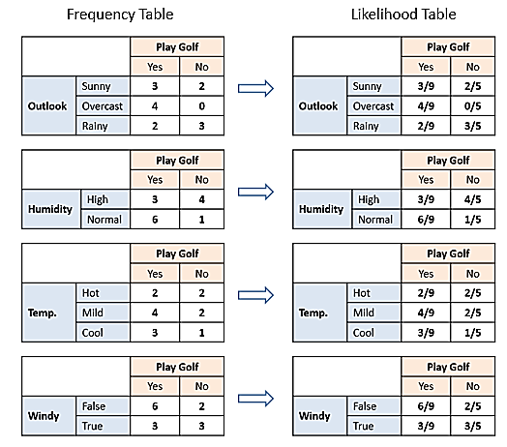

Slide 6
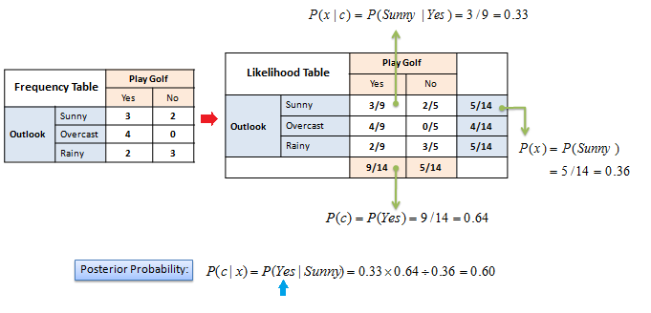

Slide 7
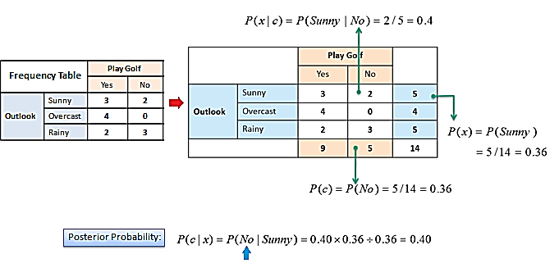

Slide 8
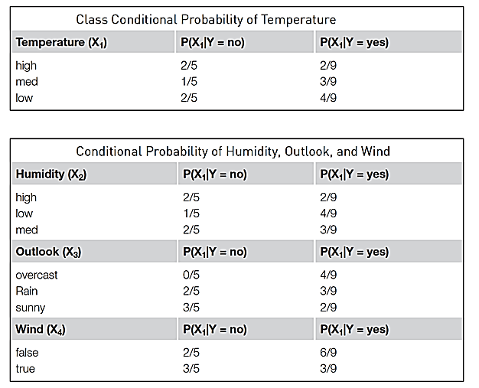
Class conditional probability

Slide 9
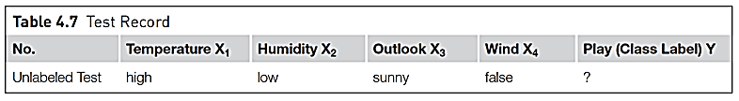
Test record

Slide 10
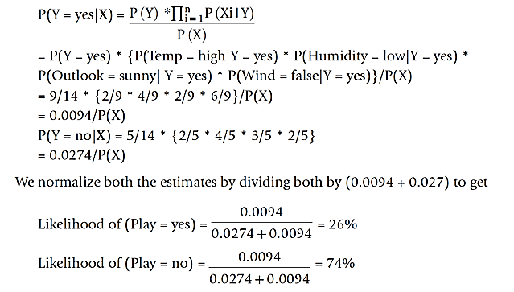
Calculation of posterior probability P(Y/X)
0.0274

Slide 11
Issues
Incomplete training set -> Use laplace correction
Continuous numeric attributes -> Use Probability density function

Slide 12
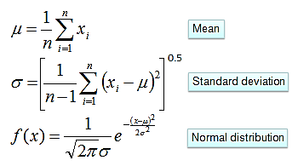
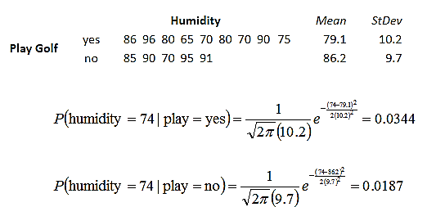
Numerical Predictors

Slide 13
More example NB

Slide 14
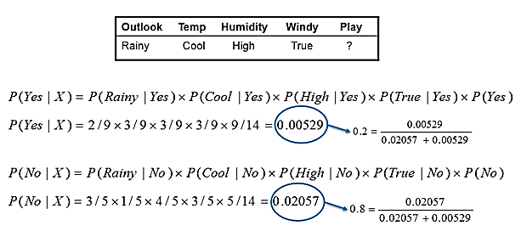

Slide 15
Example of Naïve Bayes Classifier
A: attributes
M: mammals
N: non-mammals
P(A|M)P(M) > P(A|N)P(N)
=> Mammals

Slide 16


